Slide 1
CCLearn
A Simple Personal “Closed Circuit” Distributed Machine Learning Architecture
and a comparison to Cloud-based machine learning services
By: Luke Hillard

Slide 2
Why distributed machine learning?
It allows a user control over all of their data.
It allows a user to to choose how their system learns.
It means no longer having to trust big companies with your data.
Processing power can be split between many computers.
SoC’s can handle low to medium complexity machine learning tasks.
  This means distributed learning on SoC’s can help bridge the gap in performance of cloud services.
Related work shows need for SoC training and the current architectures use dynamic update functions.
Related work shows minimal comparison in terms of performance time to fully train a model.

Slide 3
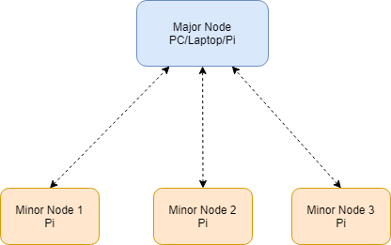
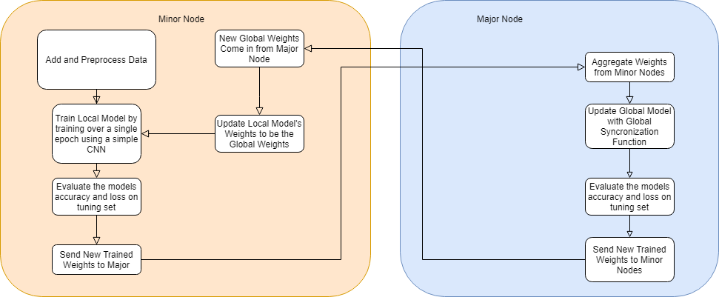
CCLearn Architecture
Can have 1 to any number nodes theoretically.
Trains over 3 update loops/epochs

Slide 4
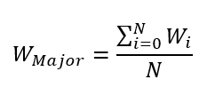
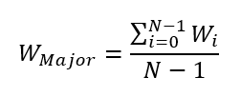
Global Synchronization Function
Wmajor = matrix of weights on the global node.
Wi = matrix of weights from minor nodes
Wn = The last Wi that is the previous Wmajor
N = Number of Minor Nodes + Major Node
The lower equation is for the first update loop where Wn is empty. This leaves it out so that it doesn't affect weight averages.
The upper equation is for every other case.
Wmajor is sent to minor nodes when calculated and evaluated.

Slide 5
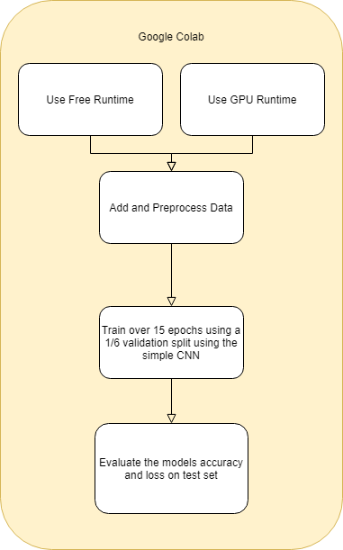
Google Colab Setup
Based on google colab cloud services.
Does 5 times the epochs.

Slide 6
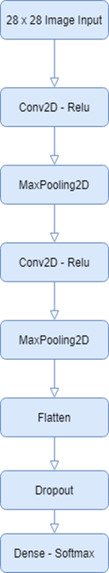
The Convolutional Neural Network
Conv2D - A layer that uses are Kernel/Filter over a 2D space and generates new weights.
MaxPooling2D - A layer that reduces the size of the 2D space and for each section takes the highest weight.
Flatten - Makes 2D data 1D
Dropout - Randomly set weights to 0 to prevent overfitting
Dense Layer - A layer with a number of nodes (10 in our case, one for each digit) that are connected to every output with the previous layer.

Slide 7
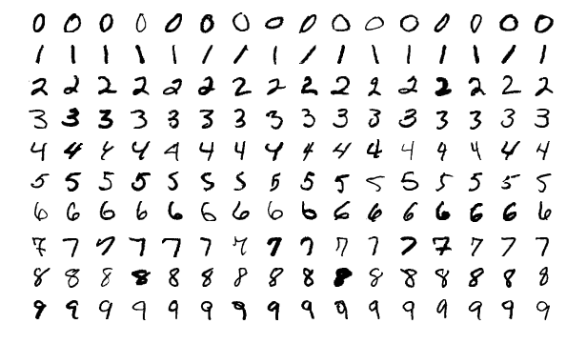
The MNIST dataset
60000 images of handwritten digits.
28 by 28 pixels.
Collected from high school students and United States census bureau workers.
Should be IID considering that they had the 2 subsets of high school students and census bureau workers and equally blended them together to create a better dataset.

Slide 8
Experimental Setup
Experiment 1:
  MNIST data set into 3 sets
    50000 from the training set as a training set.
    10000 from the training set as a tuning set.
    10000 from the testing set as a testing set.
  Google Colab does 15 epochs
  CCLearn does 3 epochs with 1 major node and 1 minor node.
  We measure time for training and evaluation of the test set and measure accuracy of the test set here
Experiment 2:
  CCLearn does 1 epochs without update loop.
  We simulate more nodes by reducing the number of images needed to train on.
    Time is the only metric we measure here

Slide 9
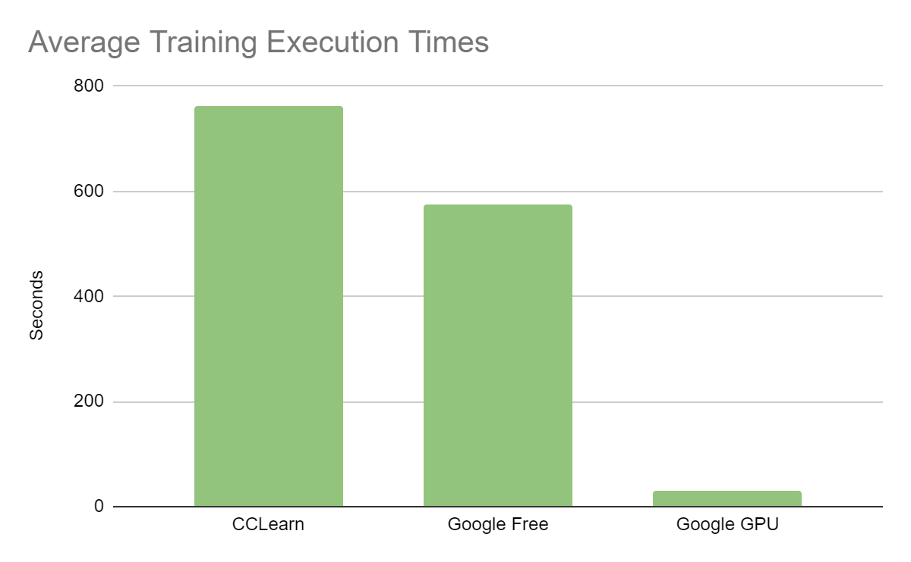
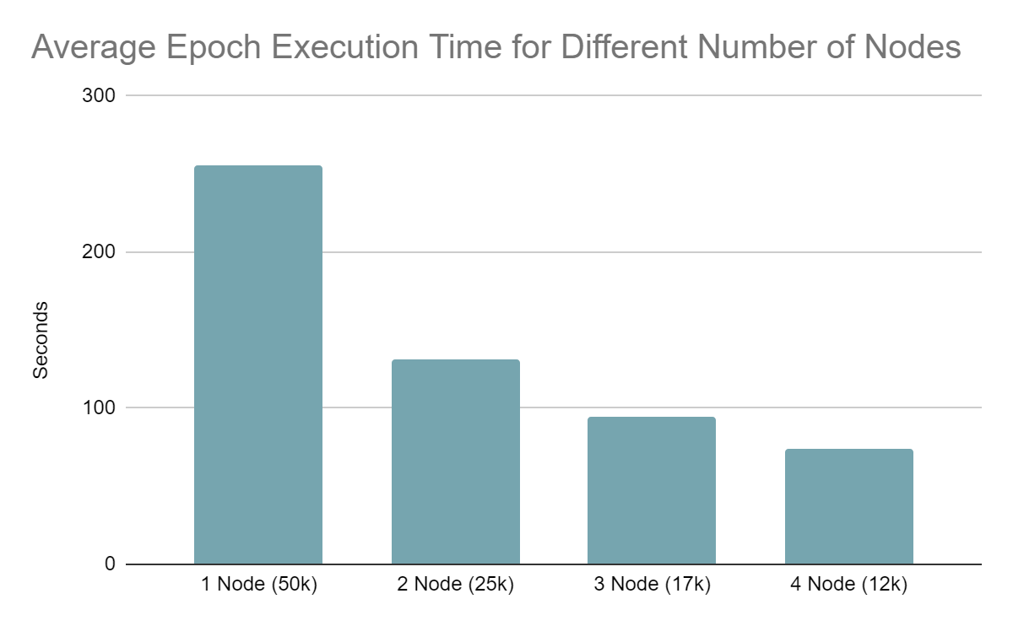
The Results
Experiment 1:
  Accuracy for CCLearn was
    98.06%
  Accuracy for Google Colab Free Runtime was
    99.11%
  Accuracy for Google Colab GPU Runtime was
    99.16%
Experiment 1:
  Evaluation time for CCLearn was
    17.56 seconds
  Evaluation time for Google Colab Free Runtime was
    2.6 seconds
  Evaluation time for Google Colab GPU Runtime was
    0.65 seconds

Slide 10

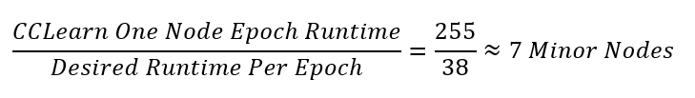
Analysis of Results
We can see that CCLearn takes 30% longer than Google Colab’s free runtime.
We see that the results when scaling down image size for training does show a multiplicative inverse relation so we can calculate how many nodes to approach the same epoch times as Google Colab’s free runtime.
7 minor nodes + 1 major nodes using Raspberry Pi Model 3 B computers is about 280 USD

Slide 11
Struggles
Raspberry Pi Zero does not have enough RAM to do the type of machine learning we want to achieve. This means it was not used.
TensorFlow Lite has no way to currently uncompress models that I could find or network them appropriately.
  TensorFlow Lite as it currently stands is to compress pretrained models for edge computing.
One of the Raspberry Pi computers checked out to me had a crippled power circuit and tended to overheat.
  This was solved with a fan and a direct power cable to a notebook computer power brick.
Could only test the minimal amount of nodes due to available Raspberry Pi’s

Slide 12
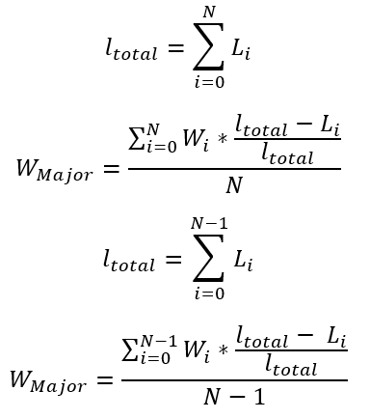
Future Work Ideas
Using the set of equations to the left using the loss to further manipulate the impact of weights. Higher loss should mean lower impact to the weighted average.
  L = Vector of loss of each minor nodes model
  ltotal = the total loss of the minor nodes
  Not confident in using loss this way.
Test CCLearn on other types of machine learning.
  Regression Tasks
  Other classification models
Test a network with more than the minimum 2 nodes.

Slide 13
Conclusions
CCLearn was able to perform a machine learning task with comparative results to Google Colab’s free runtime option.
CCLearn shows that, even though slower, that SoC distributed machine learning could be an implementation for home-based machine learning training.
CCLearn is slowed down by hardware when it comes to evaluating data. In other words, it’s slower at labeling data once trained than Google Colab’s free training.
Faster SoC technology is still being created and being made cheaper. This means we can possibly see distributed systems for machine learning training in smart homes with many SoC devices.
The results also show that SoC distributed learning architectures can be used for machine learning.

Slide 14
References
F. Chollet, “Keras documentation: Simple MNIST convnet,” Keras, 19-Jun-2015. [Online]. Available: https://keras.io/examples/vision/mnist_convnet/. [Accessed: 15-Nov-2020].
P. Duncan, “TensorFlow on a Raspberry Pi Zero is a Bad Idea,” pablotron.org, 06-Apr-2019. [Online]. Available: https://pablotron.org/2019/04/06/tensorflow-on-a-raspberry-pi-zero-w-is-a-bad-idea.html. [Accessed: 16-Nov-2020].
K. Hentschel, D. Jacob, J. Singer and M. Chalmers, "Supersensors: Raspberry Pi Devices for Smart Campus Infrastructure," 2016 IEEE 4th International Conference on Future Internet of Things and Cloud (FiCloud), Vienna, 2016, pp. 58-62, doi: 10.1109/FiCloud.2016.16.
Y. LeCun and C. Cortes, “THE MNIST DATABASE,” MNIST handwritten digit database. [Online]. Available: http://yann.lecun.com/exdb/mnist/. [Accessed: 16-Nov-2020].
T. Tuor, S. Wang, T. Salonidis, B. J. Ko and K. K. Leung, "Demo abstract: Distributed machine learning at resource-limited edge nodes," IEEE INFOCOM 2018 - IEEE Conference on Computer Communications Workshops (INFOCOM WKSHPS), Honolulu, HI, 2018, pp. 1-2, doi: 10.1109/INFCOMW.2018.8406837.
S. Wang et al., "When Edge Meets Learning: Adaptive Control for Resource-Constrained Distributed Machine Learning," IEEE INFOCOM 2018 - IEEE Conference on Computer Communications, Honolulu, HI, 2018, pp. 63-71, doi: 10.1109/INFOCOM.2018.8486403.

Slide 15
Thank you for your time!

